Slide 1
Module 2 – Leadership
Chapter 4 – How to Give Instruction
Section 2 – Lecture Procedure

Slide 2
Demonstrate knowledge of the challenge of leadership, the qualities of an effective leader, how to evaluate the performance of subordinates and how to give instruction

Slide 3
Describe the main steps of the lecture procedures for delivering instruction
Describe the advantages and disadvantages of the lecture with audiovisuals technique for presenting information
Describe the main steps of the lecture with audiovisuals procedure for delivering instruction

Slide 4
Describe the advantages and disadvantages of the demonstration technique for presenting information
Describe the main steps of the demonstration procedure for delivering instruction
Describe the advantages and disadvantages of the role playing instructional technique

Slide 5
Describe the advantages and disadvantages of the case study instructional technique
Describe the advantages and disadvantages of the discussion instructional technique
Describe the advantages and disadvantages of the cooperative learning instructional technique

Slide 6
Key Term Questions Slide Index
Click any link below to go directly to polling that question.
Materials using sight or sound to present information
Instructional technique involving spontaneous portrayal of situation
Published report that has been studied over time
Shows learners how to do task using sequential instructions
Learning activity where group members work to accomplish goal
Click here to return to this index.

Slide 7
Team Assignment
Alpha
Bravo
Charlie
Delta

Slide 8
Materials using sight or sound to present information
Audiovisual aids
Audible aids
Sensory aids
Auditory aids
1
1
1
1
(NS3-M2U1C4S2:KT1)

Slide 9
An instructional technique involving a spontaneous portrayal of a situation, condition, or circumstance by selected members of the class
Improvisation
Practice
Role playing
Make believe
1
1
1
1
(NS3-M2U1C4S2:KT2)

Slide 10
A published report about a person, group, or situation that has been studied over time; also a situation in real life that can be looked at or studied to learn about something
Biography
Life story
Case study
Memoir
1
1
1
1
(NS3-M2U1C4S2:KT3)

Slide 11
Method of teaching that shows learners how to do a task using sequential instructions with the end goal of having learners perform the tasks independently
Experimentation
Illustration
Presentation
Demonstration
1
1
1
1
(NS3-M2U1C4S2:KT4)

Slide 12
A learning activity where students are subdivided into groups or teams within which the members work with each other to accomplish a goal
Harmonious learning
Disjointed learning
Cooperative learning
Active learning
1
1
1
1
(NS3-M2U1C4S2:KT5)

Slide 13
Audiovisual aids -
Materials using sight or sound to present information
Role playing -
An instructional technique involving a spontaneous portrayal (acting out) of a situation, condition, or circumstance by selected members of the class

Slide 14
Case study -
A published report about a person, group, or situation that has been studied over time; also a situation in real life that can be looked at or studied to learn about something

Slide 15
Demonstration -
Method of teaching that shows learners how to do a task using sequential instructions with the end goal of having learners perform the tasks independently
Cooperative learning -
A learning activity where students are subdivided into groups or teams within which the members work with each other to accomplish a goal

Slide 16
Name and discuss different methods or techniques for instruction.
1.
2.
3.
Note to Instructors:
Click the Show/Hide Response Display Button

Slide 17
What is your preferred method of learning?
Lecture
Discussion
Demonstration
Role playing
Case study
Cooperative learning
1
1
1
1
1
1
(NS3-M2U1C4S2:LQ1)

Slide 18
When deciding on instruction technique, what should be taken into consideration about the learners? (Input all that apply, then push the ENTER button.)
Number
Ability
Maturity level
Previous experience
Learning style
1
1
1
1
1
(NS3-M2U1C4S2:LQ2)

Slide 19
Techniques for Instruction
Preparing to Lecture:
Prepare to lecture by:
Gathering the necessary information
Determining a point of view from which to present the subject
Tailoring the lecture to the students

Slide 20
Techniques for Instruction
Three Main Steps to Lecture:
Introduction
Presentation
Summary
1
2
3

Slide 21
Techniques for Instruction
Three Main Steps to Lecture
Introduction
Introduce yourself
State the objective
Explain the topic relevance to the student
Give an overview of the lecture
Introduction
1

Slide 22
Techniques for Instruction
Three Main Steps to Lecture
Presentation
Break the larger topics down into smaller parts
Provide examples, explanations, illustrations
Presentation
2

Slide 23
Techniques for Instruction
Three Main Steps to Lecture
Summary
Emphasize and tie together principle points of the lesson, including objectives
Summary
3

Slide 24
Techniques for Instruction
Guidelines for Effective Use of Lecture
Know the specific objectives of the topic
Ensure the lecture is well organized
Avoid boring instructing by varying voice stress and intensity
Watch the class actions (attentiveness) to determine effectiveness of the instruction

Slide 25
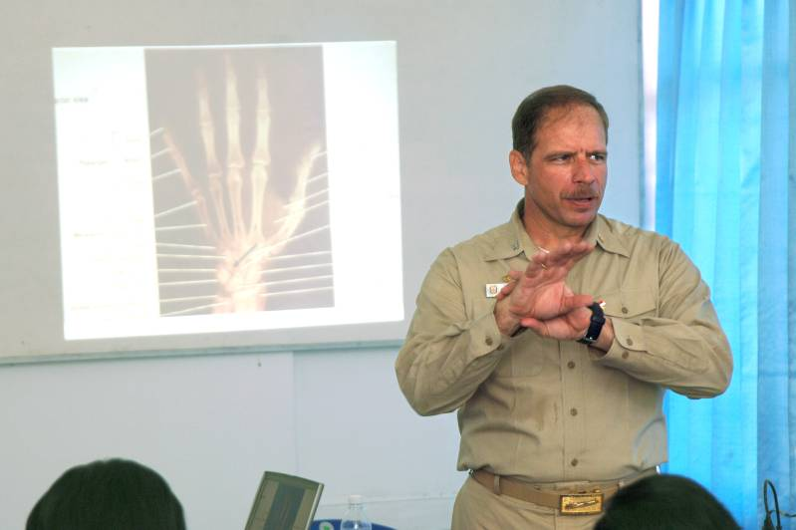
Techniques for Instruction
Examples of audiovisual aids:
Chalkboard writings
Dry-Erase Boards
Movies, Videos
Diagrams, photos, pictures
Overhead projections

Slide 26
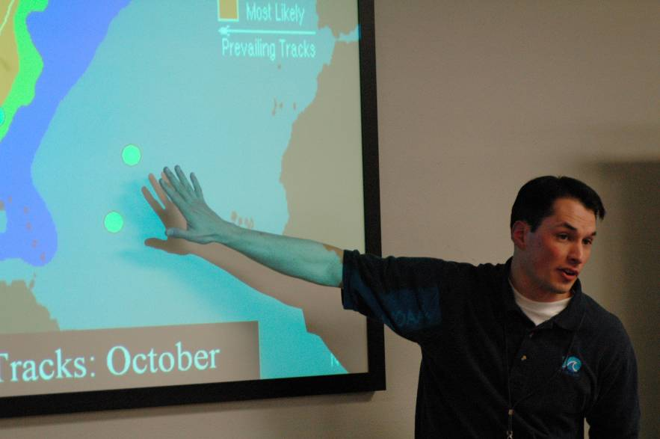
Techniques for Instruction
Audiovisual Aids Can Enhance Learning
The strategy of using audiovisual aids encourages comments and questions from students.
A multiple approach through several senses (sight, sound, etc.) makes for more complete understanding and greater retention.

Slide 27
Techniques for Instruction
Grasping Whole Concepts
Frequent use of visual materials by the instructor should help students grasp whole concepts where word explanations are often inadequate.
As soon as the object or picture is presented, the word descriptions come into focus with new meaning and lasting effect.

Slide 28
Techniques for Instruction
Advantages of Using Lecture with Audiovisual Aids
Using audiovisual aids during lectures is an efficient instructional method for presenting many facts or ideas in a relatively short time.
It is particularly suitable for introducing a subject to ensure that all students have the necessary background.

Slide 29
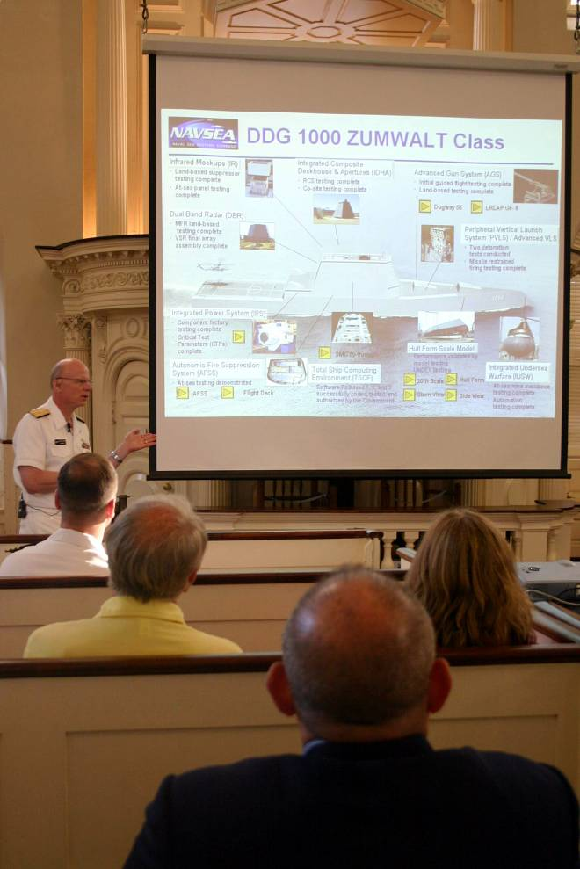
Techniques for Instruction
Advantages of Using Lecture with Audiovisual Aids
Using audiovisual aids with lecture method is often useful to supplement, summarize, or emphasize material from other sources or to provide information difficult to obtain in other ways, especially complex material.
It helps to focus the students’ attention on the specific concept being presented.

Slide 30
Techniques for Instruction
Disadvantages of Using Lecture
with Audiovisual Aids
There are disadvantages to using the lecture with audiovisual aids method:
Not good for development of motor skills
Requires considerable skill in speaking on the instructor’s part
Assumes active listening and adequate note taking skills on the part of the students

Slide 31
Techniques for Instruction
Procedure for Using Lecture with Audiovisual Aids
The delivery technique for a lecture using audiovisuals is similar to the basic lecture method discussed earlier.
Introduction
Presentation
Summary
1
2
3

Slide 32
Before a lecture is even delivered, the instructor should prepare by doing what? (Input all that apply, then push the ENTER button.)
Gathering the necessary information
Tailoring the lecture to the students
Writing out a detailed script
Recording the lecture to play back during class
1
1
1
1
(NS3-M2U1C4S2:LQ3)

Slide 33
In which step of the lecture should the instructor state the objective?
1
2
3
It does not need to be stated.
1
1
1
1
(NS3-M2U1C4S2:LQ4)

Slide 34
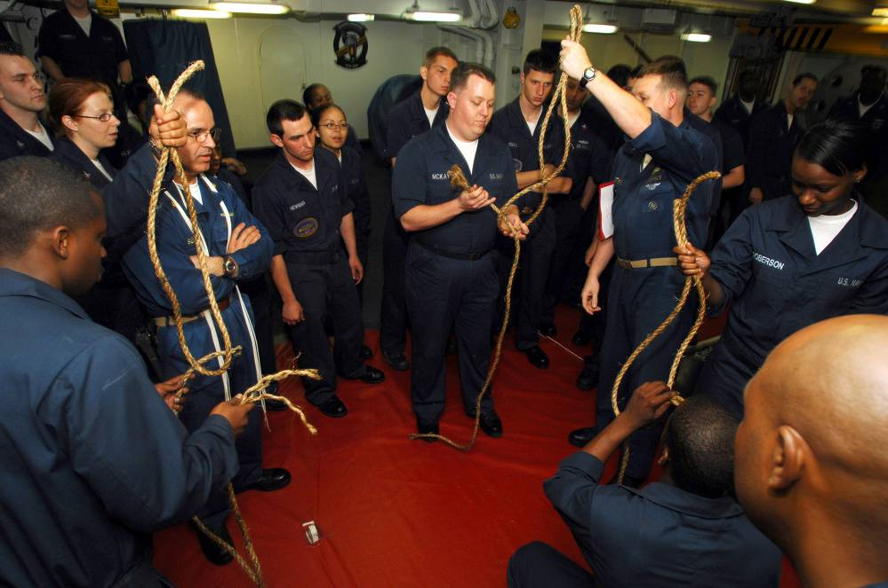
Techniques for Instruction
When to Use Demonstration
It is often appropriate to use the demonstration method when:
Teaching technique, procedure, or operation to a small group of learners
There is a need to develop students’ ability to operate equipment or acquire physical skills

Slide 35
Techniques for Instruction
Advantages of Demonstration
Some of the advantages of using the demonstration method include:
Adds to learning by giving students the opportunity to see and hear what is actually happening
Can be used to illustrate ideas, principles, and concepts for which words are inadequate
Usually holds the students’ attention

Slide 36
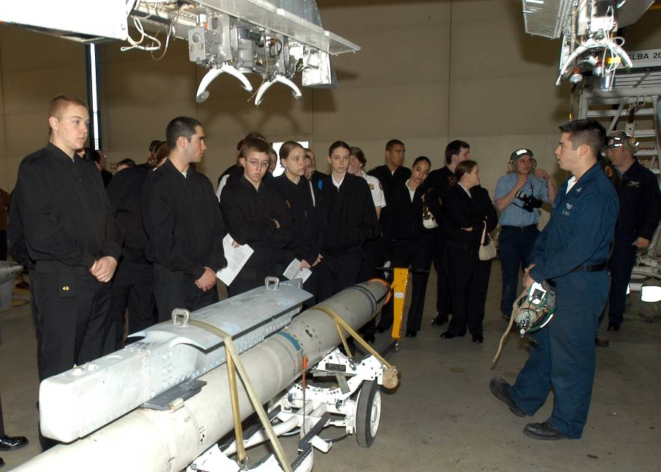
Techniques for Instruction
Advantages of Demonstration
Can save money, since only the instructor needs materials
Can reduce hazards before students begin experimentation or handling of materials involved
Can lead to a reduction in the length of trial-and-error time

Slide 37
Techniques for Instruction
Disadvantages of Demonstration
One disadvantage of using the demonstration method is that it cannot be properly used in large classrooms or with extremely small objects because all students cannot see.
Also, it can be ineffective if the instructor only “shows and tells” without obtaining feedback from students.

Slide 38
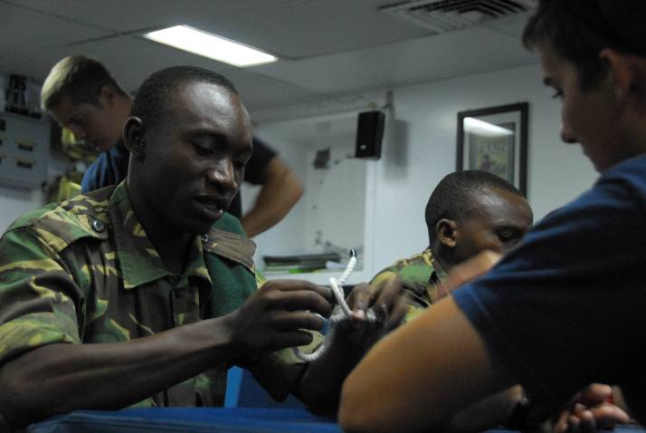
Techniques for Instruction
Disadvantages of Demonstration
Use of the demonstration method may lead to imitation without understanding.
Also, this method can become time-consuming.

Slide 39
Techniques for Instruction
Three Main Steps to Demonstration:
Show
and Tell
Repetition
Performance
1
2
3

Slide 40
Techniques for Instruction
Step One: Show and Tell
Show
and Tell
1
To complete the show and tell step:
Position the students and training aids
Ensure everyone has an unobstructed view
Show and explain the operations in step-by-step order
Say what you are doing as you perform the demonstration

Slide 41
Techniques for Instruction
Step One: Show and Tell
Show
and Tell
1
Do not emphasize speed during the initial demonstration
Ensure students understand each step before proceeding
Repeat difficult operations
Pause briefly after each operation to observe reactions and to check for understanding

Slide 42
Techniques for Instruction
Step One: Show and Tell
Show
and Tell
1
When needed, such as teaching something involving distinction between left and right, use an assistant demonstrator
Give proper attention to terminology
Carefully check students’ comprehension

Slide 43
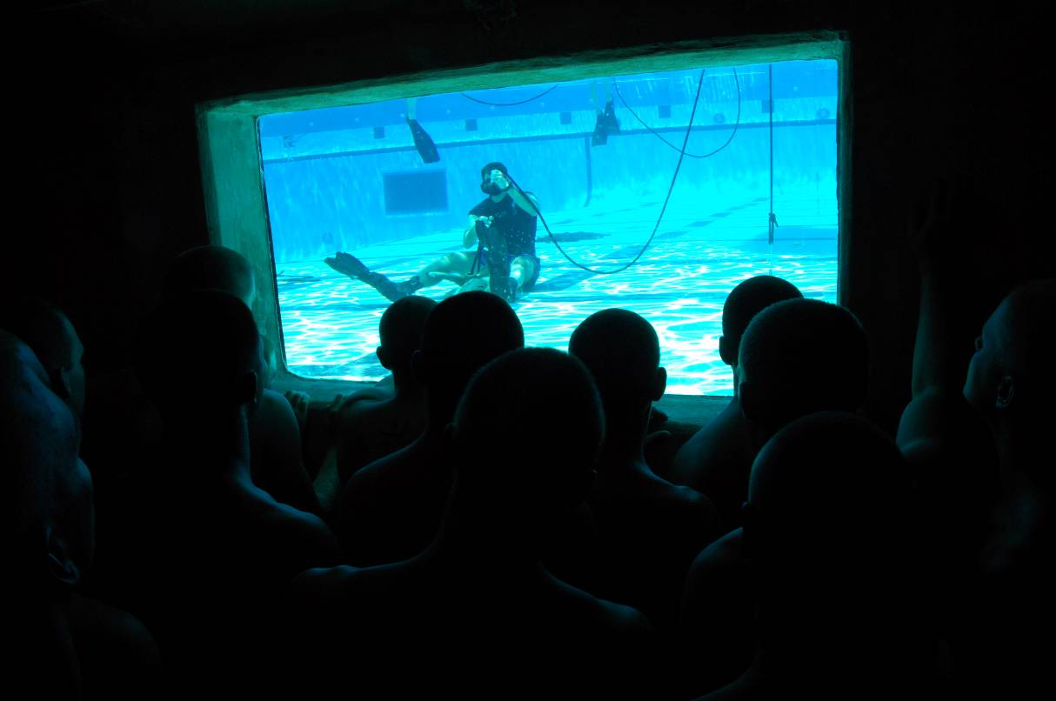
Techniques for Instruction
Step One: Show and Tell
Show
and Tell
1
Always observe safety precautions

Slide 44
Techniques for Instruction
Attention to Terminology
Use the following techniques to ensure you and your learners are paying close attention to terminology:
List the names of parts on a chalkboard or chart
Refer students to a previously made chart that shows the parts and their terminology
Conduct a terminology drill on the parts of the training aid while the aid is in its assembled or disassembled condition, as appropriate

Slide 45
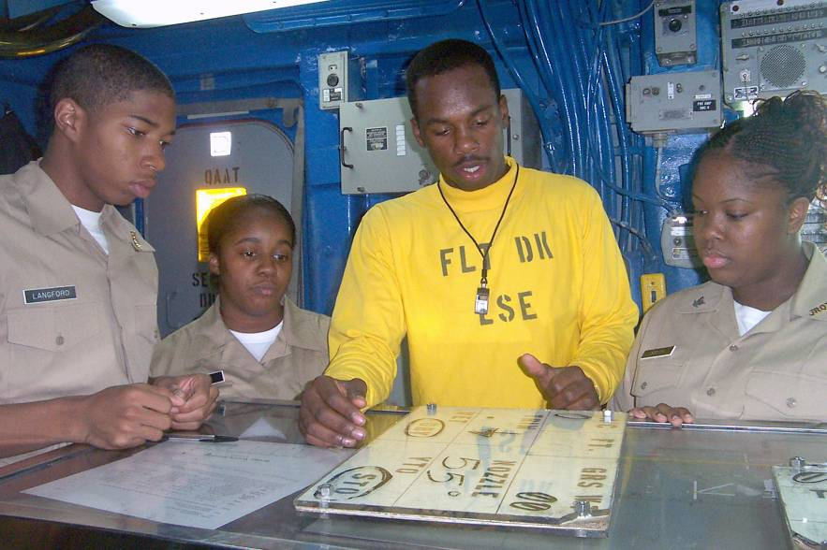
Techniques for Instruction
Check Student Comprehension
Ask questions during the demonstration that require the students to recall:
Nomenclature
Procedural steps
Underlying principles
Safety precautions

Slide 46
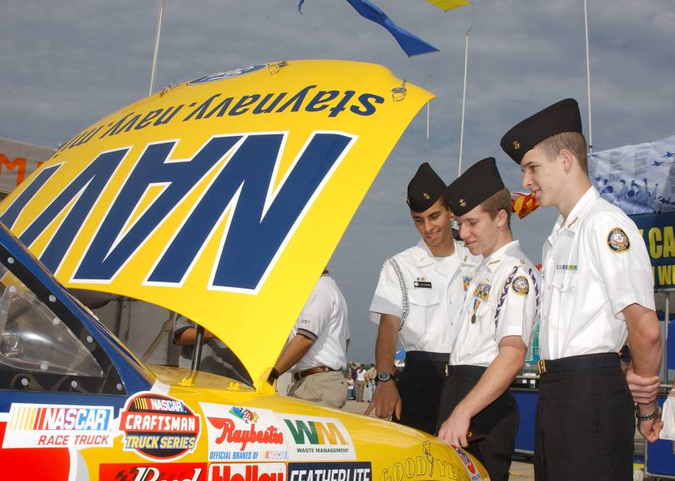
Techniques for Instruction
Check Student Comprehension
Watch the class for reactions indicating lack of attention, confusion, or doubt, but do not depend solely upon visual observations.

Slide 47
Techniques for Instruction
Step Two: Repetition
Repetition
2
Generally, there is a need for the inclusion of one or more repetition steps between the demonstration step and the performance step.

Slide 48
Techniques for Instruction
Step Three: Performance
Performance
3
The third step is the step in which the students practice under supervision until they have attained the required proficiency.
During this step, they apply what they have previously learned as a result of the demonstrations.

Slide 49
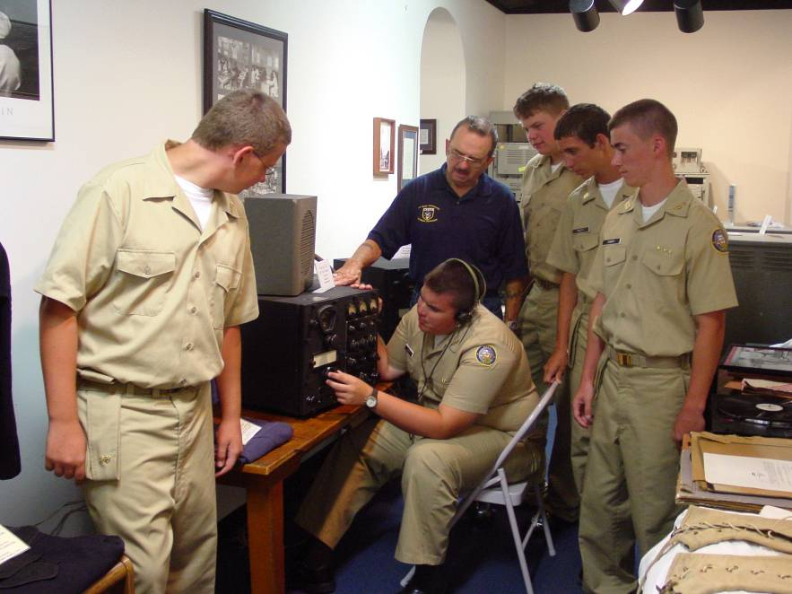
Techniques for Instruction
Guidelines for Effective Use of Demonstration
Do the following to effectively apply the demonstration method of instruction:
Practice/rehearse each demonstration in its entirety
Keep time limitations in mind
Make sure all materials are at hand

Slide 50
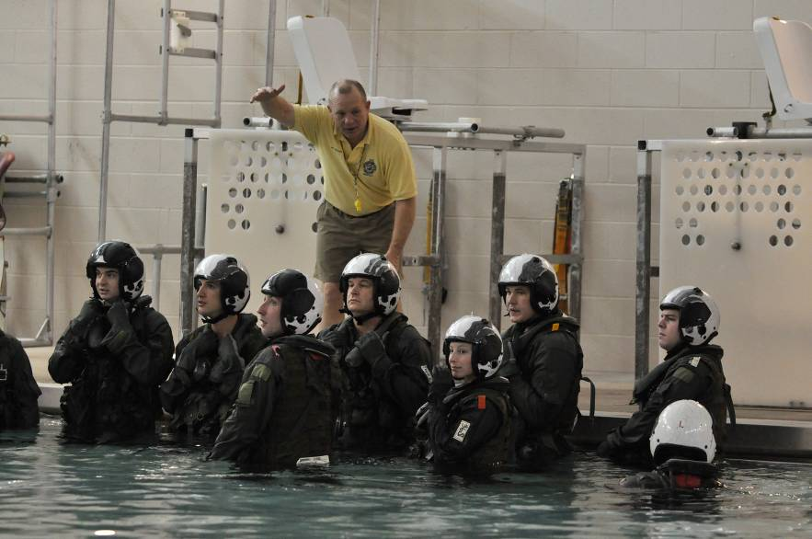
Techniques for Instruction
Guidelines for Effective Use of Demonstration
Ensure students can adequately see and hear the demonstration
Obtain feedback by using questions during the demonstration
Conduct a brief review of the steps or provide a short summary

Slide 51
Techniques for Instruction
Role-playing is an instructional technique involving a spontaneous portrayal (acting out) of a situation, condition, or circumstance by selected members of the class.
It can be a form of improvisation in which the participants assume the identity of other persons and then react as they believe those persons would in a particular situation.

Slide 52
Which of the following apply to the demonstration teaching method? (Input all that apply, then push the ENTER button.)
Reduces hazards
Works well with large groups of learners
Tough to hold students attention
Imitation without understanding
Used with techniques, procedures, or skill
1
1
1
1
1
(NS3-M2U1C4S2:LQ5)

Slide 53
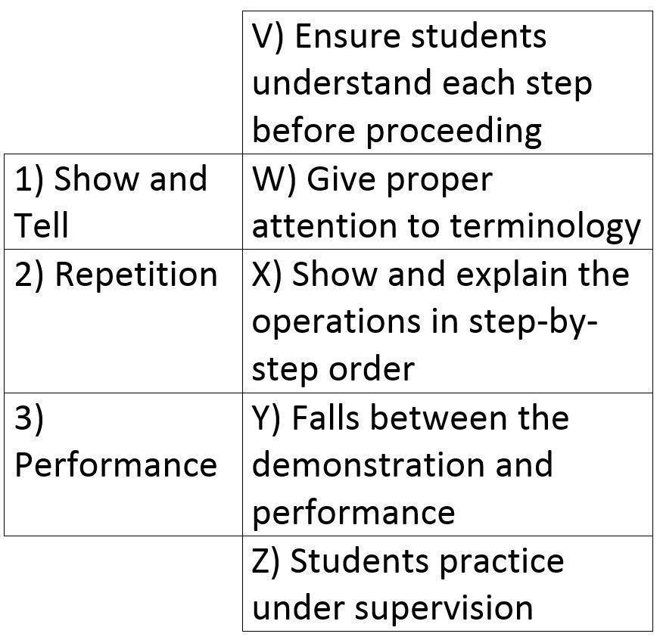
Choose the answer that correctly matches the demonstration step to the description. Each step may have more than one match.
1) VW; 2) XY; 3) Z
1) XY; 2) Z; 3) VW
1) VWX; 2) Y; 3) Z
1) X; 2) VYZ; 3) W
1
1
1
1
(NS3-M2U1C4S2:LQ6)

Slide 54
Techniques for Instruction
Uses of Role-Playing
Role-playing is especially useful when helping students to:
Understand perspectives and different ethnic and cultural backgrounds
Solve problem situations where different roles are in opposition to each other
Maximize the benefit of counseling or tutoring

Slide 55
Techniques for Instruction
Advantages of Role-Playing
Role-playing can be fun, interesting, motivating, and meaningful, and helps to break the routine of other classroom experiences.
It provides insight into common individual and group problems, reveals different attitudes, and tests various ideas in a practical situation.

Slide 56
Techniques for Instruction
Advantages of Role-Playing
Through the use of role-playing students learn to organize thoughts and responses instantly while reacting to a situation or question.

Slide 57
Techniques for Instruction
Disadvantages of Role-Playing
There are several disadvantages to the use of role-playing:
Students sometimes emphasize performance (showing off) over the intended objectives of the topic
It is time-consuming
Some students are unable to identify with the roles or situation

Slide 58
Techniques for Instruction
Disadvantages of Role-Playing
“Hot topics” and controversial issues can get out of hand
It may benefit only the actual participants unless the objectives for the class have been clearly specified

Slide 59
Techniques for Instruction
Case Studies Challenge Learners
The following happens during the application of the case study method of instruction:
Students receive a “case” - a report containing
all pertinent data
2. Students then must:
a. Analyze the data
Evaluate the problem
Decide upon principles
Recommend a solution

Slide 60
Techniques for Instruction
Using Case Studies
Each case may be handled by:
A whole class
Subgroups of a class
An individual
Each case may be designed to be handled in varied time periods, ranging from a single class period to an entire course.

Slide 61
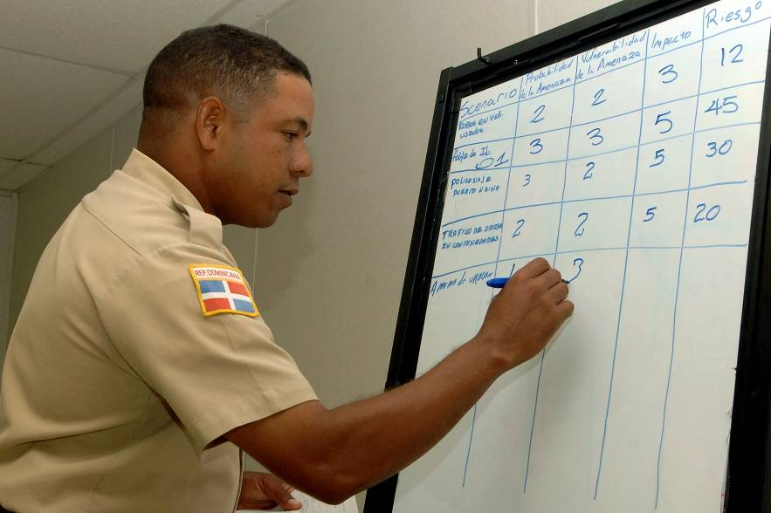
Techniques for Instruction
Case Studies and Analysis
Analysis of the data involves such things as…
The use of reference materials prepared for the study, or
Knowledge and theory already possessed by others and listed in manuals and books

Slide 62
Techniques for Instruction
Case Studies and Analysis
Evaluating and determining applicable principles calls upon the students to make some kind of “reasons-why-this-has-happened” statement.

Slide 63
Techniques for Instruction
Case Studies and Recommendations
Recommended solutions should be a natural outgrowth of case study analysis and evaluation.
Analysis + Evaluation = Solution

Slide 64
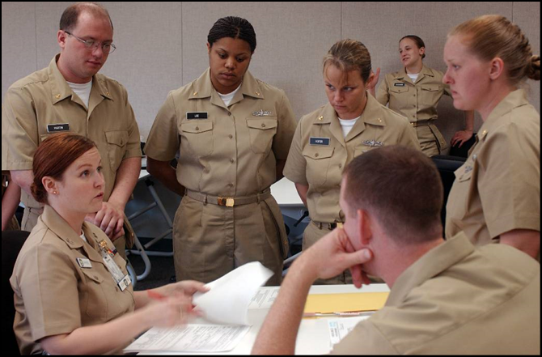
Techniques for Instruction
A discussion is a supervised conversation during which the students take an active role by stating their views on a certain topic, at the same time that the instructor guides the group to discover certain principles.
Examples of discussion types include:
Whole-class discussions
Debates
Panels
Buzz-sessions
Forums

Slide 65
Techniques for Instruction
Ways of Implementing Discussion
A few ways to include discussion in instruction:
Ask questions
Clarify comments
Make tentative summaries
Place emphasis on student-centered rather than instructor-centered learning

Slide 66
Techniques for Instruction
Benefits of Discussion
Some of the benefits of employing the discussion method include:
Helps develop attitudes
Challenges and/or reinforces individual values and beliefs
Develops questioning skills and responses
Increases motivation
Active, not passive
Maintains a high degree of mental alertness

Slide 67
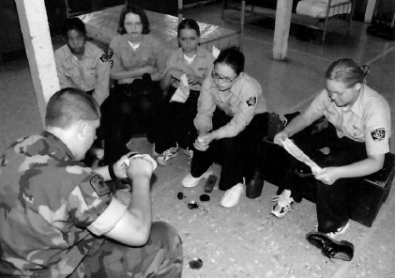
Techniques for Instruction
Cooperative Learning
In cooperative learning, a class of students is subdivided into groups or teams within which the members work with and depend upon each other to accomplish a learning goal.

Slide 68
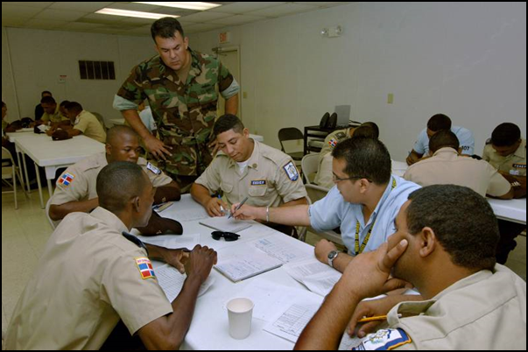
Techniques for Instruction
Steps in the Cooperative Learning Process
Learners are divided into groups.
Each team member accomplishes some portion of the assigned objective as an individual goal.
They then instruct other team members about what they have learned or accomplished, and receive similar information from the other members.
….continued

Slide 69
Techniques for Instruction
Steps in the Cooperative Learning Process
Team members are encouraged to assist others to achieve their individual goals when needed, and to work together to achieve the overall group objective.
The instructor monitors the individual group activities and may be used as a resource for the group, but does not actively take part in the group work effort.

Slide 70
Techniques for Instruction
When to Use Cooperative Learning
It is good to use cooperative learning when sufficient time is available for the group to do the following with information:
Gather
Discuss
Digest
Disseminate
Cooperative learning is effective when the material to be learned is complex or important, or requires both mastery and retention in long-term memory.

Slide 71
Conclusion
When deciding on instructional technique, consider….
Number, ability, maturity level, and previous experience of the students
Nature of the subject matter
What needs to be emphasized – skills, knowledge, or values/attitudes
Time requirements
Demands the technique will make on the instructor and students
Materials required
Results expected

Slide 72
Conclusion
No Single Correct Way to Instruct
Some things can be learned more thoroughly by observation or group involvement than through lectures or drill.
Some materials need experimental and demonstration treatment.
Controversial topics lend themselves best to discussion or role-playing.
The instructor should master all of the techniques.

Slide 73
Discuss some of the specific reasons that an instructor should thoroughly rehearse a lesson before presenting it.
1.
2.
3.
Note to Instructors:
Click the Show/Hide Response Display Button

Slide 74
In which teaching method do students receive a report they must analyze?
Discussion
Role playing
Cooperative learning
Case study
1
1
1
1
(NS3-M2U1C4S2:LQ7)

Slide 75
An instructor needs to teach the concept of reverse-discrimination. Which is the best method to use?
Discussion
Role playing
Lecture
It depends on a variety of factors.
1
1
1
1
(NS3-M2U1C4S2:LQ8)

Slide 77
Leaderboard
Last
Slide
Points | Participant | Points | Participant

Slide 78
Team Scores
Last
Slide
Points | Team | Points | Team

Slide 79
Team MVP
Last
Slide
Points | Team | Participant

Slide 80
Whiteboard
Last
Slide

